Slide 1

Kafka Streams
Dima Ionut Daniel

Slide 2
Contents
What are Kafka Streams ?
Architecture
Concepts
Core
Bibliography

Slide 3

What are Kafka Streams ?
Easy data processing and transformation library within Kafka
A client library for building applications and microservices where the input and the output data are stored in the Kafka cluster
There is no need to create a separate cluster
Highly scalable, elastic and fault tolerant
One record at a time processing, no batching
The API was introduced as part of Kafka 0.10 (2016) and it's fully mature as part of Kafka 0.11.0.0 (June 2017)

Slide 4
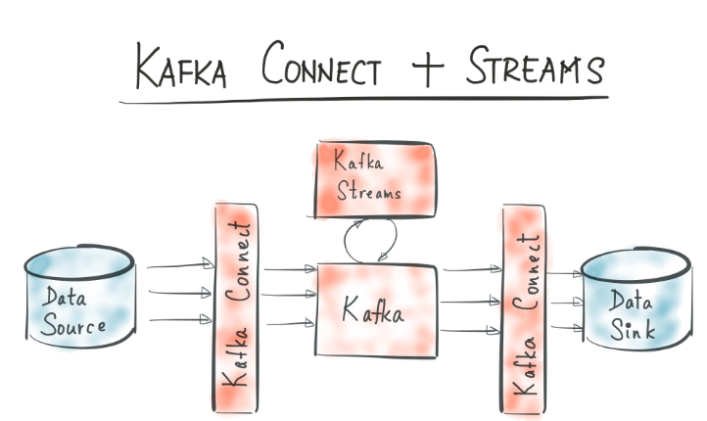
Architecture

Slide 5
Concepts
A stream is a sequence of immutable data records, fully ordered, can be replayed and is fault tolerant
A stream processor is a node in the processor topology (graph).
It transforms incoming streams, record by record and may create a new stream from it.
A source processor is a special processor that takes its data directly from a Kafka Topic. It has no predecessors in a topology and doesn't transform the data.

Slide 6
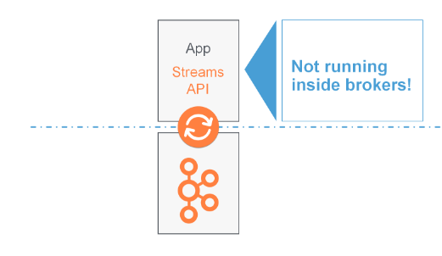
Concepts (cont.)
A stream processing application is any program that makes use of Kafka Streams library.
The stream processing application doesn't run inside a broker, instead ir runs in a separate JVM instance or in a separate cluster.

Slide 7
Concepts (cont.)
Stream processing applications that don't require state are called stateless.
Applications that process streams and require state are called stateful.
Stream-table duality means that a stream can be viewed as a table, and a table can be viewed as a stream.
The Kafka Stream DSL(Domain Specific Language) is built on top of the Streams Processor API.
A KStream is an abstraction of a record stream, where each record represents a self-contained datum in the unbounded data set.
A KTable is an abstraction of a changelog stream, where each data record represents an update.

Slide 8
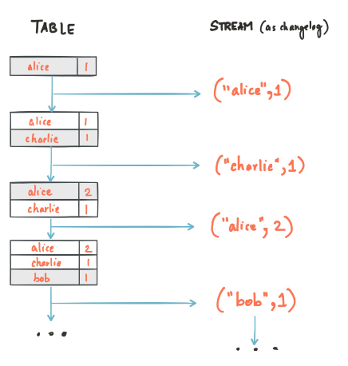
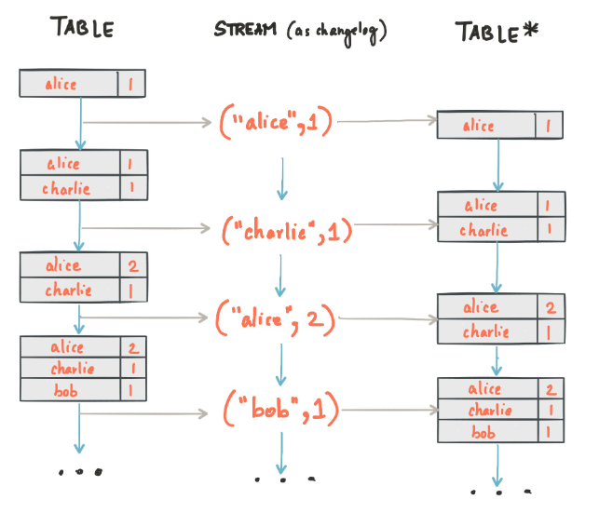
Concepts (cont.)
A simple form of a table is a collection of key-value pairs, called map or associative array.
A stream-table duality describes the close relationship between streams and tables.
Stream as table: Each record in the stream captures a state change of the table.
Table as stream: A table can be considered a snapshot, at a point in time, of the latest value for each key in a stream.

Slide 9
Concepts (cont.)
KStream reading from a topic that's not compacted.
KTable reading from a topic that's log-compacted.
KStream is a new data is partial information/transactional.
KTable if we need a structure that's like a database table where every update is self sufficient.

Slide 10
Core
Kafka Streams provides 2 APIs to define stream processors:
Declarative functional DSL, where built-in operations are map and filter.
Imperative, lower-level Processor API provides more flexibility than the DSL.

Slide 11
Core (cont.)
Streams application properties
All configurations from Kafka are applicable.
bootstrap.servers: where to connect, usually port 9092
auto.offset.reset.config: set to "earliest" to consume the topic from the start
application.id: specific to Streams applications:
consumer group.id = application.id
default client.id prefix
prefix to internal changelog topics
default.[key|value].serde: for serialization and deserialization of the data

Slide 12
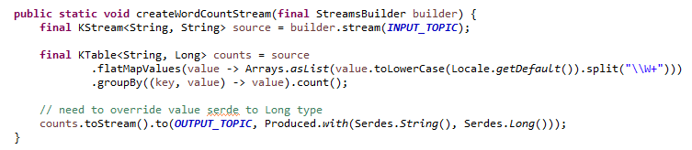
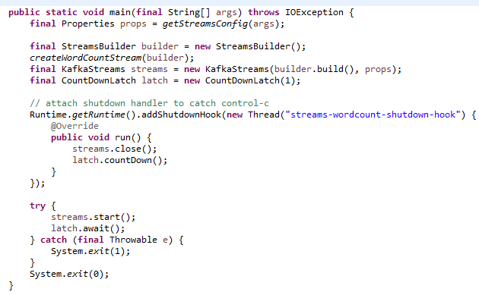
Core (cont.)
Word Count stream application example

Slide 13
Core (cont.)
MapValues/Map takes one record and produces one record.
MapValues
is only affecting values
== does not change keys
== does not trigger a repartition
for KStreams and KTables
Map
affects both keys and values
triggers a re-partition
for KStreams only

Slide 14
Core (cont.)
Filter/FilterNot takes one record and produces zero or one record
Filter
does not change keys/values
== does not trigger a repartition
for KStreams and KTables
FilterNot
inverse of Filter

Slide 15
Core (cont.)
FlatMapValues/FlatMap takes on record and produces zero, one or more record
FlatMapValues
does not change keys
== does not trigger a repartition
for KStreams only
FlatMap
change keys
== triggers a repartition
for KStreams only

Slide 16
Core (cont.)
Branch (split) a KStream based on one or more predicates
Predicates are evaluated in order, it no matches, records are dropped
We get multiple KStreams as a result

Slide 17
Core (cont.)
SelectKey
assigns a new key to the record, from old key and value
== marks the data for re-partitioning
best practice to isolate that transformation to know exactly where the partitioning happens

Slide 18
Core (cont.)
We can read a topic as a KStream, a KTable or a GlobalKTable.
KStream<String,Long> wordCount = builder.stream(Serdes.String(), Serdes.Long(), "topic-name")
KTable<String,Long> wordCount = builder.table(Serdes.String(), Serdes.Long(), "topic-name")
GlobalKTable<String,Long> wordCount = builder.globalTable(Serdes.String(), Serdes.Long(), "topic-name")

Slide 19
Core (cont.)
We can write any KStream, or KTable back to Kafka
If we write a KTable back to Kafka, it's best to create a log compacted topic.
To: terminal operation, write the records to a topic:
stream.to("topic-name");
table.to("topic-name");
Through: write to a topic and get a stream/table from the topic
KStream<String,Long> newStream = stream.through("topic-name");
KTable<String,Long> newStream = table.through("topic-name");

Slide 20
Core (cont.)
As soon as an operation can possible change the key, the stream will be marked for repartition: Map, FlatMap, SelectKey.
Repartitioning is done seamlessly behind the scenes but will incur a performance cost (read and write to Kafka).

Slide 21
Core (cont.)
Log Compaction can be a huge improvement in performance when dealing with KTables because eventually records can be discarded.
This means less reads to get to the final state, less time to recover.
Log Compaction has to be enabled on topics that get created (source or sink topics).
Log compactions ensures that the log contains at least the last known value for a specific key within a partition.
We just require a SNAPSHOT instead of full history, we only keep the latest "update" for a key in our log.

Slide 22
Core (cont.)
Transform a KTable to a Kstream in oder to keep a changelog of all the changes to the KTable.
KStream<byte[],String> stream = table.toStream();
Transforming a KStream to a KTable:
chain a groupByKey() and an aggregation step (count,aggregate,reduce)
KTable<String,Long> tabke = users.groupByKey().count();
write back to Kafka and read as KTable
stream.to("intermediary-topic");
KTable<String,String> table = builder.table("intermediary-topic");

Slide 23
Conclussion
Elastic, highly scalable, fault-tolerant
Fully integrated with Kafka security
Exactly-once processing semantics
No separate processing cluster required

Slide 24

Bibliography
https://docs.confluent.io/platform/current/streams/concepts.html
Udemy – Kafka Streams

Slide 25
Questions ?

